Slide 1
A Brief Intro To GMAT: Impulsive and Finite Burn Planning

Slide 2
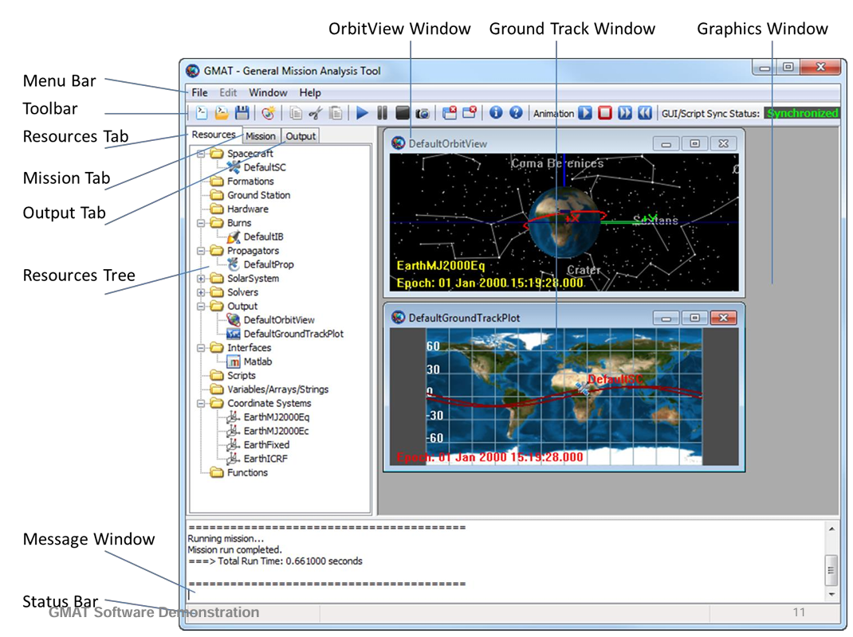
GMAT At a Glance
Link: https://sourceforge.net/projects/gmat/
Open-source space mission design and simulation software
Written / maintained by NASA GSFC
Used to support TESS mission design CDR
Under development since 2002 (design started), released 2013
Similar (but not identical) capabilities for space mission design as other industry-standard tools e.g. Freeflyer, STK, etc.
Image source: Using the General Mission Analysis Tool (GMAT), Hughes, Conway, et al. (2017)

Slide 3
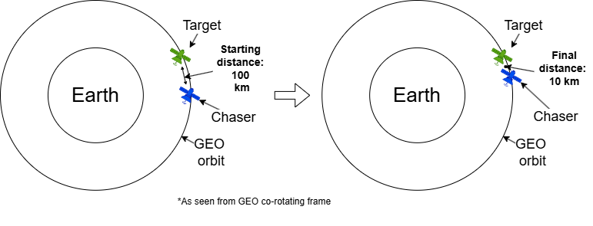
An Example Use Case (Phasing Maneuver)
Example problem is (loosely) adapted from https://orbital-mechanics.space/orbital-maneuvers/phasing-maneuvers.html
Initial time: March 21, 2028, 12:00:00 UTC
Target and Chaser spacecraft are both in circular GEO orbits with ~0 deg inclination
Chaser is initially 100 km away from Target spacecraft
Chaser is planning to maneuver towards the Target and circularize 10 km away from the Target (standoff distance before proceeding with closer-proximity operations)
Target is prograde of chaser initially

Slide 4
More Details re: Setup
Target orbital parameters:
Semimajor axis: 42,164.15 km
Eccentricity: 0.0
Inclination: 0.0
Right ascension of ascending node: 0.0
Argument of perigee: 0.0
True anomaly: 0.0
Chaser orbit: initially co-planar with Target’s orbit
Assumptions:
Chaser needs 15 minutes to prepare for a burn maneuver
Want to quickly close the distance, so Chaser will phase after one revolution to close to 10 km
Assuming Target starts with R-vector through ECI X-axis with +Y axis velocity

Slide 5
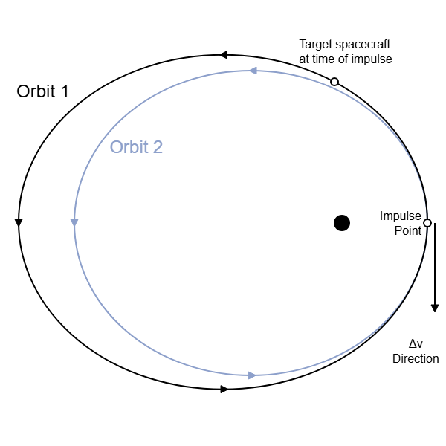
Phasing Orbit
We want to put the Chaser into a phasing orbit to catch up to the Target
Hence, our orbital period for our transfer orbit (Orbit 2 shown right) must be shorter than our final orbit
To get from Orbit 1 to Orbit 2, we first need to burn retrograde for Burn1
To circularize onto our final orbit, we will burn prograde at the intersection of Orbit 1 and Orbit 2
We will model these burns as ideal impulsive maneuvers (lower-fidelity but acceptable for initial mission analysis / trade studies)
Burn 2
Burn 1
Image credit: https://orbital-mechanics.space/orbital-maneuvers/phasing-maneuvers.html

Slide 6
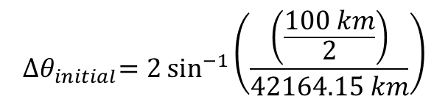
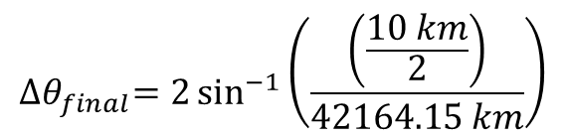
Some Trigonometry To Help Us
100 km
10 km
42164 km
42164 km
42164 km
42164 km
$${∆θ}_{initial}=2\sin^{−1}\left(\frac{\left(\frac{100 km}{2}\right)}{42164.15 km}\right)$$
$${∆θ}_{final}=2\sin^{−1}\left(\frac{\left(\frac{10 km}{2}\right)}{42164.15 km}\right)$$

Slide 7
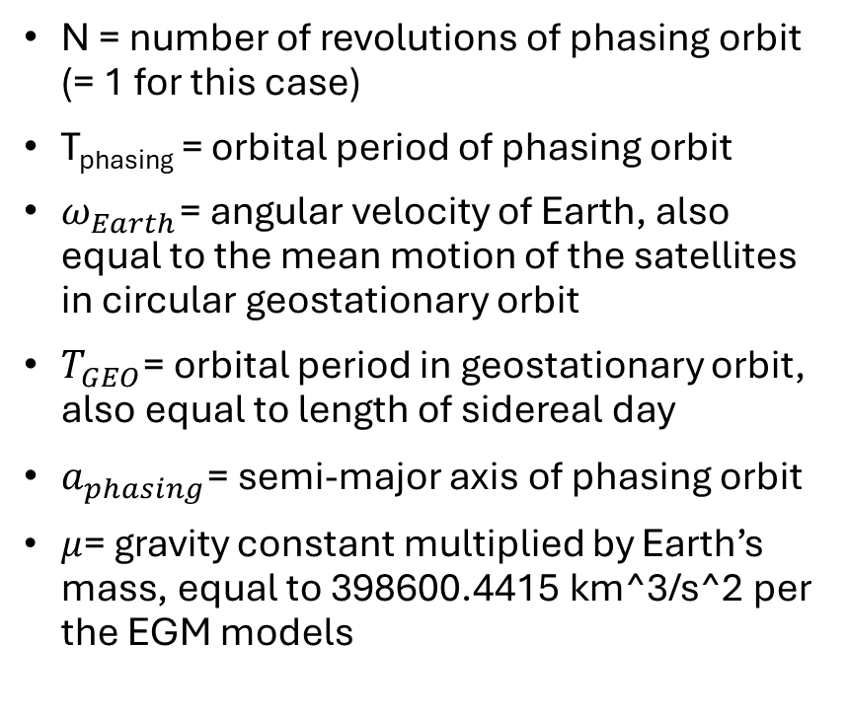
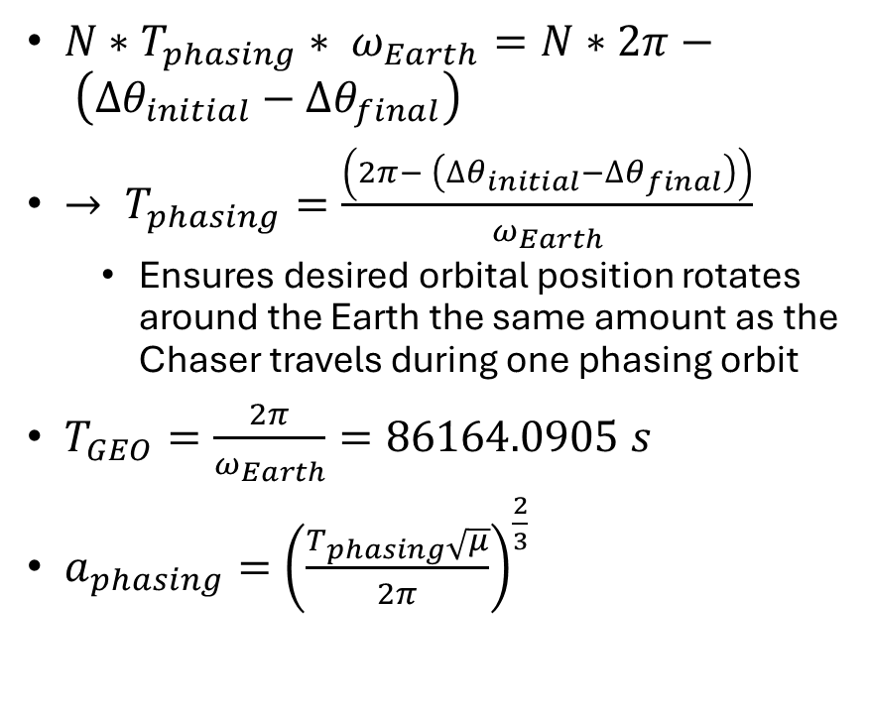
More Math
$N∗T_{phasing}∗ ω_{Earth}=N∗2π− \left({∆θ}_{initial}−{∆θ}_{final}\right)$
$→ T_{phasing}=\frac{\left(2π− \left({∆θ}_{initial}−{∆θ}_{final}\right)\right)}{ω_{Earth}}$
Ensures desired orbital position rotates around the Earth the same amount as the Chaser travels during one phasing orbit
$T_{GEO}=\frac{2π}{ω_{Earth}}=86164.0905 s$
$a_{phasing}={\left(\frac{T_{phasing}\sqrt{μ}}{2π}\right)}^{\frac{2}{3}}$
N = number of revolutions of phasing orbit (= 1 for this case)
T_{phasing} = orbital period of phasing orbit
$ω_{Earth}$= angular velocity of Earth, also equal to the mean motion of the satellites in circular geostationary orbit
$T_{GEO}$= orbital period in geostationary orbit, also equal to length of sidereal day
$a_{phasing}$= semi-major axis of phasing orbit
$μ$= gravity constant multiplied by Earth’s mass, equal to 398600.4415 km^3/s^2 per the EGM models

Slide 8
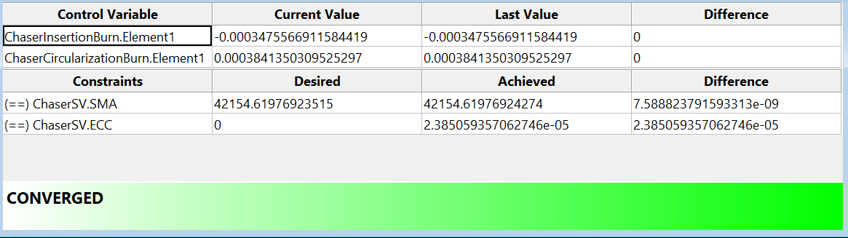
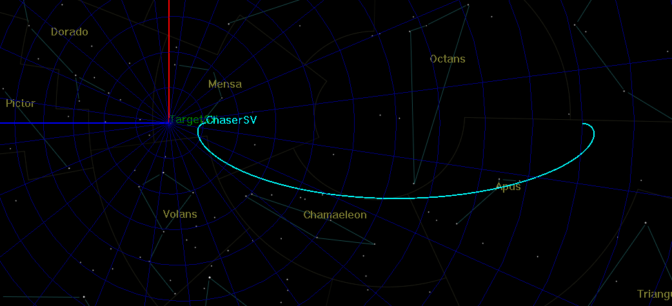
How Do We Do?
Start at 100 km
End at ~10 km
V_{target}
Nadir
Total of 0.73 m/s of delta-V

Slide 9
Next Steps Necessary To Improve Fidelity
Model propulsion system performance using finite burns instead of impulsive maneuvers
Ensure propulsion system thrust and specific impulse are modeled according to empirical data
Verify additional constraints that may be applicable for CONOPS (power system performance in and out of eclipse, attitude constraints / pointing performance, time required for TTC ground links / crosslinks / etc.)
Verify other CONOPS-related use cases / scenarios, e.g. maneuver aborts, hardware failures, flight / ground anomalies

